Slide 1
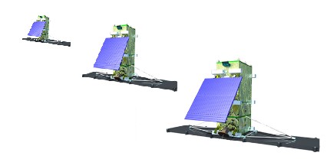
ISO/TS 19159-4 Calibration and validation of remote sensing imagery sensors — Part 4: Space-borne microwave radiometers
1
2
3
Zoom Virtual Meeting
22, Apr. 2021, 9:00 am Eastern Time, 14:00 UTC

Slide 2
Outline
Updates since last meeting
On the questions related to the data dictionary from Tobias
Next step

Slide 3
Update Since last meeting
Received 6 comments from Tobias on April 14, 2021.
Answered the questions, with addition of some sample data.
No. | Line | Addition of sample data
1 | Lines 26, 27 | Yes
2 | Lines 28
3 | Lines 32 | Yes
4 | Lines 46
5 | Lines 49
6 | Lines 63 | Yes

Slide 4
On the questions related to the data dictionary from Tobias
Q1: For lines 26, 27: USBLimit and LSBLimit, these were changed from Real to Vector. Based on the description, it appears as though these are two-value Vectors containing lower and upper range values for USBLimit and LSBLimit respectively. Is this correct?
 | Name/Rolename | Definition | Obligation/ Condition | Max occurrence | Data type/ Class | Domain
26. | USBLimit | Frequency range of the Upper Side Band | M | 1 | Vector <Real> | >0, the unit is GHz
27. | LSBLimit | Frequency range of the Lower Side Band | M | 1 | Vector <Real> | >0, the unit is GHz

Slide 5
On the questions related to the data dictionary from Tobias
A1: USBLimit and LSBLimit have two applications in CAL/Val of microwave radiometer:
Case 1: USBLimit and LSBLimit are used as input frequencies of band-corrections in applying brightness temperatures of the calibration target at the central frequencies for representing the brightness temperatures at the upper and lower passbands.
Case 2: USBLimit and LSBLimit are used as input frequencies of spectralResponse, as mentioned in following Q3. In this case, USBLimit and LSBLimit includes many frequencies within the upper band and the lower band. Therefore, USBLimit and LSBLimit should be treated as a vector, which is a list of frequencies.

Slide 6
On the questions related to the data dictionary from Tobias
Table 1: An example of the channel 7 of MWHS on FY-3D satellite. with a bandwidth of 0.192GHz at each band
Band | Frequency(GHz) | Band response function (Weights)
LSB | 116.1526 | 0.034773
 | 116.1674 | 0.039172
 | 116.1821 | 0.041576
 | 116.1969 | 0.041576
 | 116.2117 | 0.046835
 | 116.2265 | 0.046835
 | 116.2412 | 0.036907
 | 116.256 | 0.036907
 | 116.2708 | 0.034773
 | 116.2856 | 0.034773
 | 116.3003 | 0.030869
 | 116.3151 | 0.029084
 | 116.3299 | 0.024326
 | 116.3447 | 0.021594
Band | Frequency(GHz) | Band response function (Weights)
USB | 116.1526 | 0.034773
 | 116.1674 | 0.039172
 | 116.1821 | 0.041576
 | 116.1969 | 0.041576
 | 116.2117 | 0.046835
 | 116.2265 | 0.046835
 | 116.2412 | 0.036907
 | 116.256 | 0.036907
 | 116.2708 | 0.034773
 | 116.2856 | 0.034773
 | 116.3003 | 0.030869
 | 116.3151 | 0.029084
 | 116.3299 | 0.024326
 | 116.3447 | 0.021594
Case 1: usually the lower band limit refers to the range of [116.1526,116.3447], and the upper limit refers to the range of [121.1554, 121.3474], For simplification, sometimes the central frequencies of 116.2486 and 121.2514 GHz are given for the LSB and USB limits.
Case 2: the upper band and the lower band refers to all the frequencies listed in Table 1.

Slide 7
On the questions related to the data dictionary from Tobias
Q2: For line 28: polarizationMode. Could you review the definition for this item? The type is set of string, but the definition looks as though it should be a list of four values, or should it be one of the four values in the domain description?
 | Name/Rolename | Definition | Obligation/ Condition | Max occurrence | Data type/ Class | Domain
28. | polarizationMode | Polarization mode of the radiometer, usually referring to vertical and horizontal polarization, which corresponding to the first two modified Stokes parameters, most generally referring to the four Stokes parameters. | M | 1 | String | vertical-polarization, horizontal polarization, the third Stokes parameter, the fourth Stokes parameter

Slide 8
On the questions related to the data dictionary from Tobias
A2: The polarization mode is the characteristic of a radiometer, for example a horizontal polarization microwave radiometer.
Generally, Polarization is defined as the direction of the electric (E) or magnetic (H) field in a propagating electromagnetic wave.
The Stokes parameters (a set of 4 values (I, Q, U, V)) were introduced as a mathematically convenient alternative by Sir George Stokes. These four parameters are related to the horizontally and vertically polarized components of electric field. The units of the Stokes parameters are W/m².
For microwave remote sensing, modified Stokes parameters are often used (the unites are converted to Kelvin).
From the definition above, polarizationMode is a set of string as {‘v-pol’,’h-pol’,’U-pol’,’V-pol’}. It can also be defined as a codelist.

Slide 9
On the questions related to the data dictionary from Tobias
Q3: For line 32: spectralResponseFunction. Could you review the definition for this item and reference to radio: “weights or radio at”. Also, if the data is weight at USBLimit and LSBLimit, could you confirm how the data should be structured?
 | Name/Rolename | Definition | Obligation/ Condition | Max occurrence | Data type/ Class | Domain
32. | spectralResponseFunction | Spectral response weights or radio ratio at the frequencies within the bandwidth of the receiver. | M | 1 | CA_SpectralResponseFunction or weights at the USBLimit and LSBLimit

Slide 10
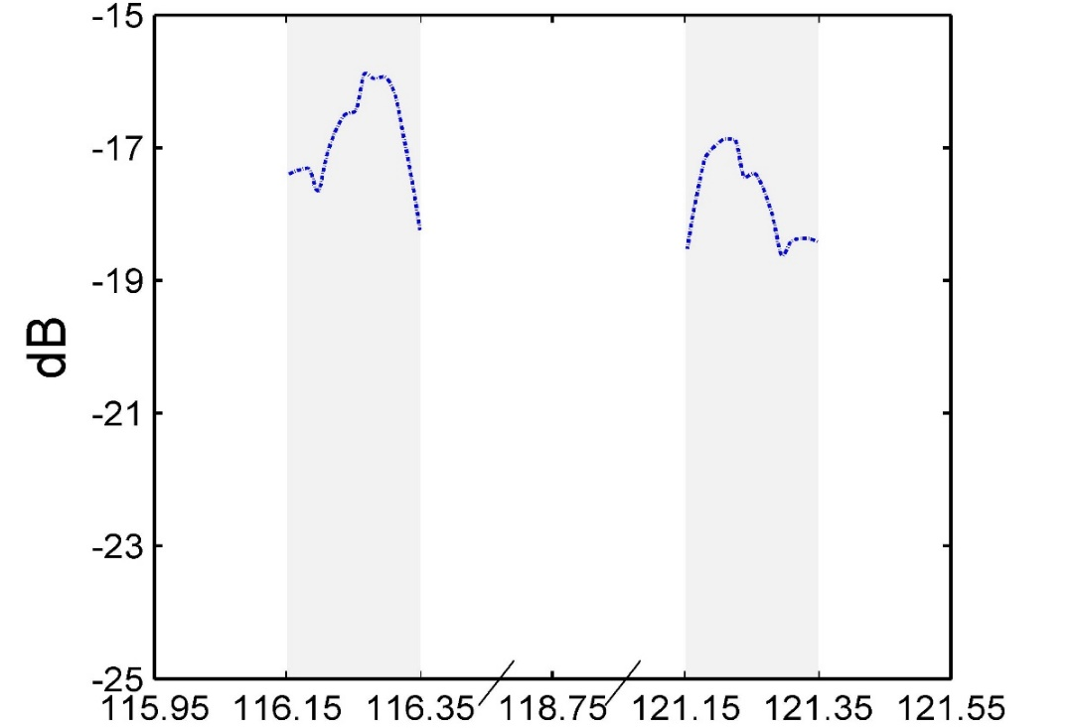
On the questions related to the data dictionary from Tobias
A3: Usually spectralResponseFunction is defined as a table as Table 1, which includes a column of frequencies and a column of weights, and the weights are normalized with the sum of 1. The number of frequencies in the band is depended on the representative of those weights of the frequency to the band response function, since the data of weight are discretized from the response function as following figure 1, which should be converted into absolute ratio with no unit. Please refers to 3.32 in Clause 3. Terms and definitions.
3.32 SRF
relative sensitivity of the sensor to monochromatic radiation of different wavelengths
Figure 1: SRF of ch. 7 of MWHS on FY-3D satellite (x-axis is frequency in GHz, and y-axis is response function in dB)

Slide 11
On the questions related to the data dictionary from Tobias
Q4: For line 46: pattern. Could you review the definition for this item? The last part should be reworded for clarity “, at least them should be given in E- and H- cuts of the ports of the antenna”. Regarding the data, my interpretation is that you would expect a structure like an array with multiple rows containing the following columns:
a. Elevation angle
b. Azimuth angle
c. Amplitude
d. Phase
 | Name/Rolename | Definition | Obligation/ Condition | Max occurrence | Data type/ Class | Domain
46. | pattern | Complex pattern including the amplitude and phase at different elevation angles and azimuth angles; at least them they should be given in E- and H- cuts of the ports of the antenna. | M | 1 | Vector/ array

Slide 12
On the questions related to the data dictionary from Tobias
A4: You are right, the general form is usually given as you listed with 4 columns of El. Angle, Az. Angle, Amplitude and the phase. Sometimes, it was given by another form with 4 columns of x-component of co-polarization, y-component of co-polarization, x-component of cross-polarization, y-component of cross-polarization, while the elevation angle and azimuth angle are informed by the setting of configurations of the test. Certainly, the final form of the pattern may be requested or regulated by the form you given. Thanks.

Slide 13
On the questions related to the data dictionary from Tobias
Q5: For item 49: spectralResponse. Could you review the definition? I suspect “response rates or radio” should be “response rates or ratio”. Also, based on the description, my interpretation is that you would expect a structure like an array with multiple rows containing the following columns:
a. Frequency
b. Response weight or ratio
 | Name/Rolename | Definition | Obligation/ Condition | Max occurrence | Data type/ Class | Domain
49. | spectralResponse | response weights or radio ratio at the frequencies within the bandwidth of the receiver | M | 1 | Vector/array | Usually in normalized weights in dB, --100 <= spectralResponseFunction ->Value<= 1
A5: Yes, you are right. Please see the Table 1.

Slide 14
On the questions related to the data dictionary from Tobias
Q6: For line 63 – nonlinearityCoefficient. Could you review the definition for me. The text seems to imply that the value should be a list of operating temperatures and correction coefficients, or is this one coefficient based on the recorded receiverTemperature (Line 59)?
 | Name/Rolename | Definition | Obligation/ Condition | Max occurrence | Data type/ Class | Domain
63. | nonlinearityCoefficient | coefficients at different operation temperatures of the radiometer for correcting the nonlinear contributions of the system. | M | 1 | Real | 0<=nonlinearityCoefficient - > Value <= 1

Slide 15
On the questions related to the data dictionary from Tobias
A6: Nonlinearity coefficient u is used for correction the deviation of the real calibration equation to the two-point calibration: u is a function of the receiver temperature, but at prelaunch thermal/vacuum test, it is impossible to get all the coefficients at each possible receiver temperature, so it’s usually derived from 3, or 4 receiver temperatures, which cover the range of working temperature on board. The application of u onboard into the calibration equation is done by interpolating or looking up it from the prelaunch results, which includes at least two columns of the receiver temperatures and u at the corresponding temperature.
Table 2 Parameter u (with uncertainty) for three channels of MWHS at receiver temperatures of 281.3 and 290.7 K
Receiver Intermediate Frequency (IF) Temperature (K) | Ch. 3 | Ch. 4 | Ch. 5
281.3 | 0.0053 (0.0008) | 0.0029 (0.0004) | 0.0078 (0.0014)
290.7 | 0.0076 (0.0005) | 0.0040 (0.0005) | 0.0052 (0.0006)

Slide 16
Next step
i. Completely finalize the data dictionary as soon as possible, and send a copy of the finalized document to Tobias when complete.
ii. Send Tobias some example data (if Table 1 and Table 2 are not enough) to work with in (i). It does not have to be complete but could compose what we have available to us.
iii. After sending (i) and (ii), Invite Tobias to ensure UML and data dictionary consistencies, and xml is in order.

Slide 17
Thank you

